Slide 1
AGM 2017 8th June 2017

Slide 2
Agenda
Welcome
Activity Report 2016 – May 2017
Conferences & Events
Training Courses
Publications
Other key activities
Financial Report 2016
AOB / Questions
Closing

Slide 3
Activity Report 2016 – May 2017

Slide 4
Conferences and Events
June 2016 : Round table on Control Functions for “C Level” yearly training
Joint event ALRIM HoT / ATTF
March 2017: ALRiM Roundtable on Governance around Backtesting
April 2017: Roundtable on Portfolio Management
Joint event ALCO - ALRiM – CFA - IIA
May 2017: 8th Annual ALFI-ALRiM Risk Management Conference
Joint event ALFI – ALRiM

Slide 5
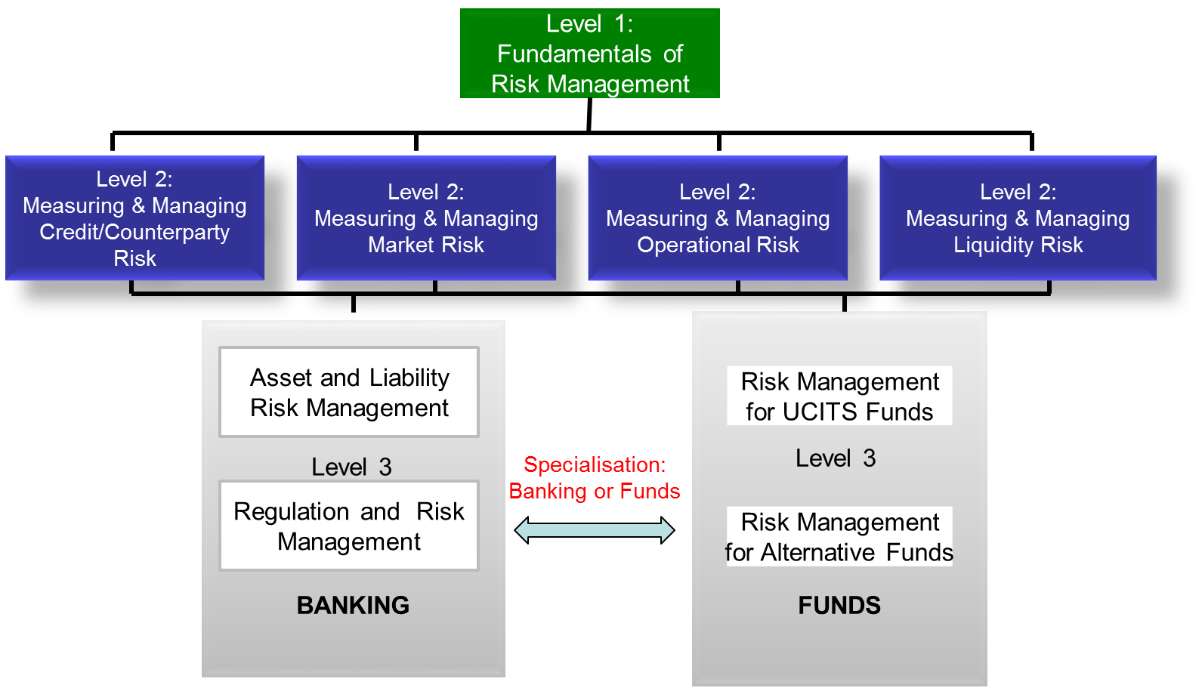
Training Courses on Risk Management Luxembourg Full Programme Structure

Slide 6
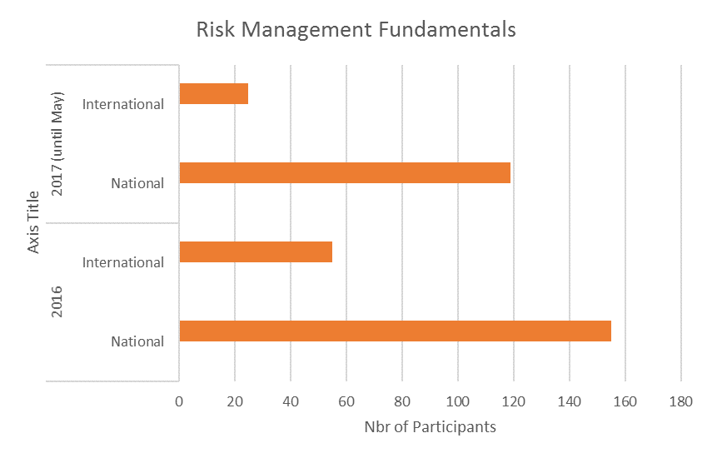

Slide 7
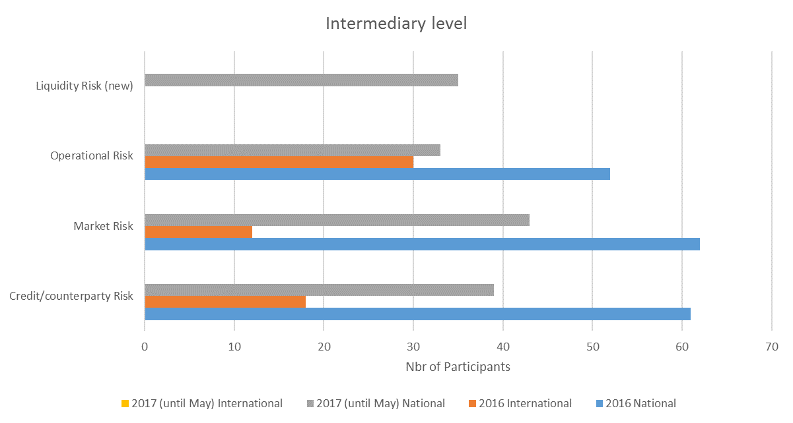

Slide 8
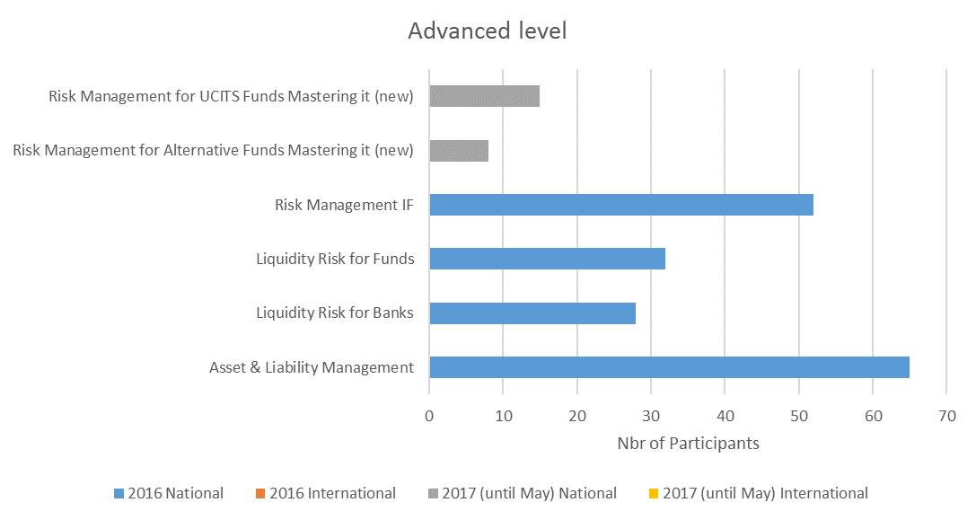

Slide 9
Publications
‘A.B.C. of VaR Model Backtesting’
Joint publication ALFI – ALRiM
LEO : ‘Effective Risk Management in Today’s World’
Joint publication LFF – ALRiM
‘VaR Model Backtesting C.S.I. – Practitioners Thoughts’
Joint publication ALFI – ALRiM

Slide 10
Other Key Activities
Contribution to conferences with other associations and professionals
Partnership with ALFI for annual conferences continued
Successful continuation of training programmes on risk management with House of Training and formalisation of partnership
Development of vision of Luxembourg fund industry as a centre of excellence for Risk Management
Social Networks: ALRiM Linkedin page which gathered 280+ followers, as well as a Twitter account (50 followers)
Presence in:
the ‘Fondation ABBL’
the ‘Advisory Board’ of the Luxembourg School of Finance
The ‘Commission Consultative Banques et Finance’ of the House of Training
ALFI Risk Management steering committee
Comité Consultatif Anti-Blanchiment of CSSF
ADA - Risk for micro finance
FERMA : scientific committee

Slide 11
Financial Report

Slide 12
Financial Report
Audit for 2016 by iCare
Copy of the Financial Statements will be available via the members’ section of ALRiM’s website
Continuation of iCare’s mandate
Discharge of:
Directors
Commissaire aux Comptes (iCare)
Treasurer

Slide 13
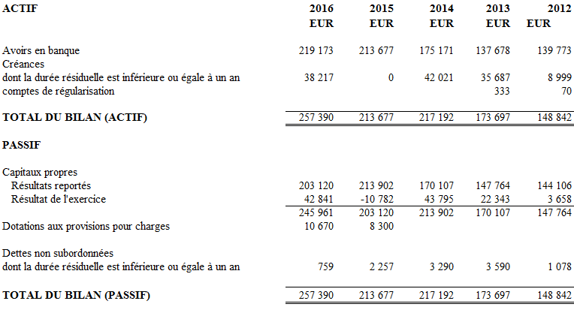
Balance Sheet (31st Dec 2016)

Slide 14
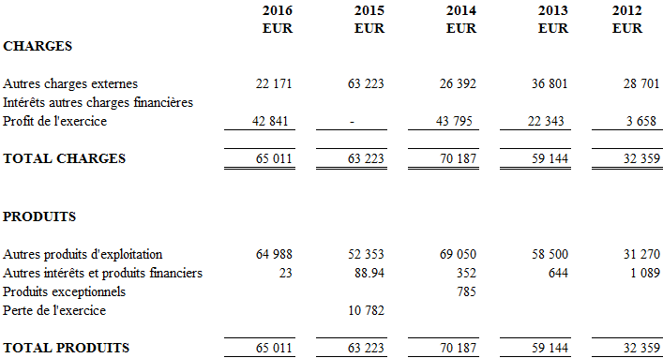
P&L (31st Dec 2016)

Slide 15
Any Other Busisness / Questions

Slide 16
ALRiM Board

Slide 17
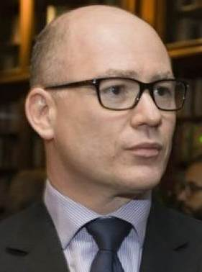
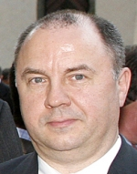
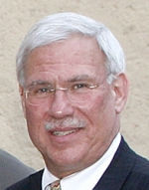
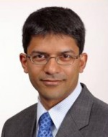
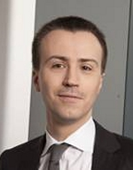
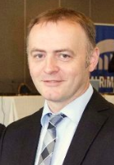
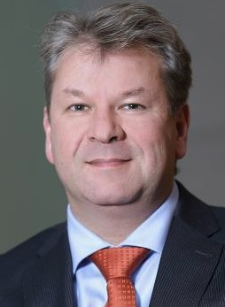
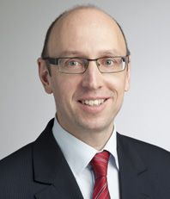
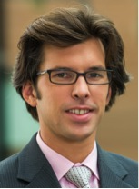
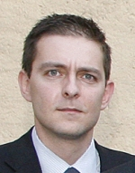
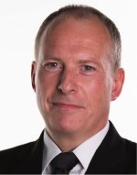
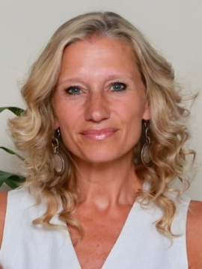

Slide 18
Closing

